Slide 1

Helmet Detection System for Two Wheeler
Vehicles Using Machine Learning
(Bachelor of Technology Degree in Computer Science & Engineering)
Submitted By:
Kartikeya Bhatt - 2018423
Abhishek Joshi - 2018078
Gaurav Singh - 2061812
Name of Guides:
Dr. Vikrant Sharma
(Assistant Professor)
Dr. Satvik Vats
(Assistant Professor)

Slide 2
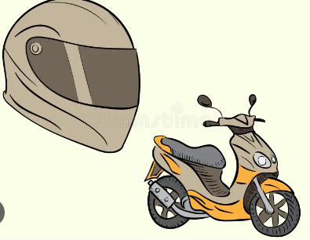
Presentation Outline
Introduction
Problem Statement
Methodology
Dataset
Implementation
Result
Future Scope
Conclusion

Slide 3
INTRODUCTION
Objective: Purpose and importance of Helmet Detection.
Key Points:
  Increasing road accidents and the need for automated
  safety measures.
  The role of helmets in reducing head injuries and
  fatalities.
  India's Motor Vehicle Act, Section 129.
  World Health Organization (WHO), promoting helmets
  right can lower the risk of deadly harms by 42% and
  the risk of head harms by 69%.
Notes:
9

Slide 4
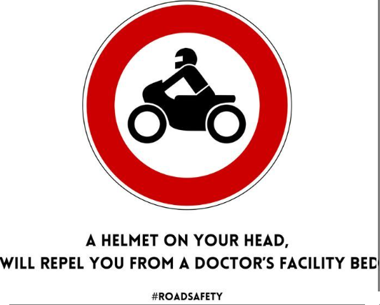
PROBLEM STATEMENT
Manual helmet checking is impractical in heavy traffic.
Need for an automated, real-time system to enforce helmet laws.

Slide 5
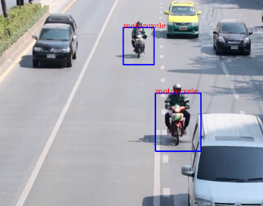
METHODOLOGY
Two-Wheeler Vehicles Detection
  Utilized pre-trained YOLOv5 model and Python script to identify two-wheelers vehicles.
  Objective: Extract cropped images of two-wheelers for further analysis.
  Fig.1. Two-Wheeler Vehicle Detection

Slide 6
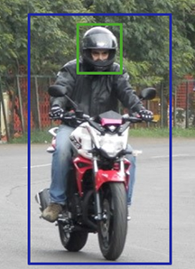
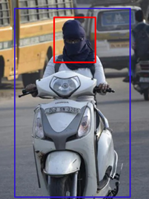
Helmet Detection
  Model Training: Employed YOLOv8 algorithm to train
  the model for helmet identification.
  Fig.2. Rider with Helmet Fig.3. Rider without helmet
  The green frame in Fig. 2 denotes the successful identification
  of a helmet-wearing rider. On the other hand, Fig. 3 with
  the red frame, indicates that a rider has been found who
  is not wearing a helmet .

Slide 7
DATASET
  Data Collection: Acquired 1,371 images supplemented with additional data for model improvement.
  Data Preparation: Resized images to 416x416 format, manually labeled for precise helmet detection.
  Validation Set: Utilized a special set of 126 images to enhance model accuracy.
  Utilized YOLOv8 algorithm for training to detect helmets accurately.

Slide 8
IMPLEMENTATION
Phase 1: Two-Wheeler Vehicles Detection (YOLOv5)
  Traffic video input.
  YOLOv5 identifies two-wheelers vehicles.
  Selected two-wheelers proceed to the next step.
Phase 2: Helmet Detection (YOLOv8)
  Selected two-wheelers vehicles images analyzed using YOLOv8.
  YOLOv8 checks for helmet usage on riders.
  Helmets are detected on riders.

Slide 9
Visual Representation
  Riders wearing helmets marked with green box.
  Riders not wearing helmets marked with red box.
  Green line signifies compliance with safety rules.
  Red line indicates non-compliance.
System's Effectiveness
  Clear distinction between helmet-wearing and
  non-wearing riders.
  Utilization of YOLOv5 and YOLOv8 enhances system’s accuracy and precision.

Slide 10
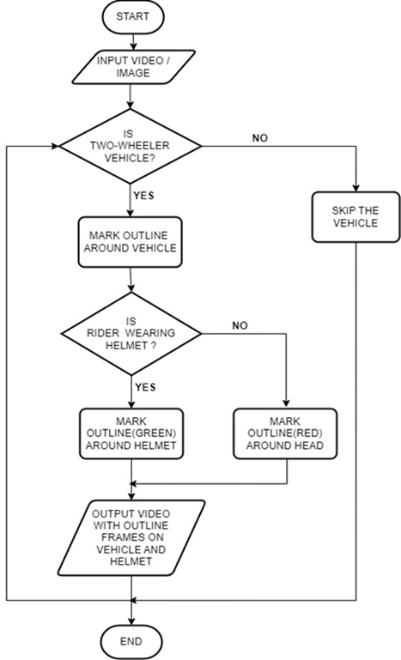
Fig. 4. Working of Helmet Detection System (Flow Chart)

Slide 11
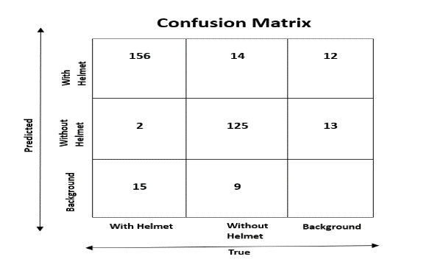
RESULTS
The model's accuracy was assessed by dividing the correctly predicted occurrences by the total number of occurrences in the dataset. Out of 346 occurrences, 281 were accurately predicted, resulting in an accuracy rate of approximately 81.32%.
Fig.5. Confusion matrix

Slide 12
FUTURE SCOPE
Enhancing Model Accuracy.
Real World Traffic Surveillance.
Smart Device Integration: Instant Feedback for Rider Safety.
Electronic Fines for Helmet Violations via Number Plate Identification.

Slide 13
CONCLUSION
The research presents a novel application of machine learning algorithms, specifically YOLOv5 and YOLOv8, for real-time
helmet detection in traffic scenarios, showcasing the potential
of AI in enhancing road safety measures.
While achieving an initial accuracy rate of 81%, the project highlights the need for ongoing refinement and dataset expansion to further improve the model's effectiveness, underscoring the importance of continuous development in addressing road safety challenges.

Slide 14
THANK YOU

